Slide 1

Understanding Blockchain Using WesleyCoin
Author: Aiden Wesley
December 7th, 2023

Slide 2
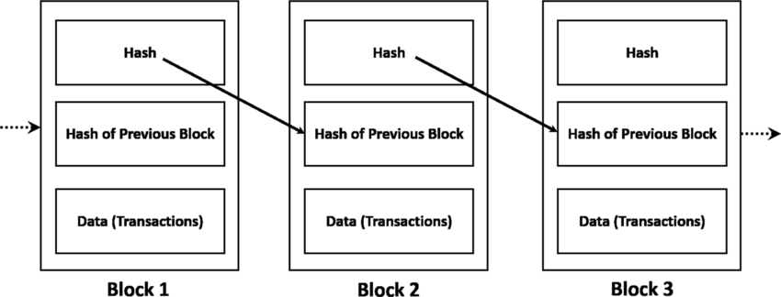
What is the Blockchain?
Blockchain Overview:
Decentralized, distributed ledger technology.
Consists of a chain of blocks, each containing a list of records.
Versatility Beyond Cryptocurrency:
Typically used with cryptocurrency but not limited to it.
Eliminating Intermediaries:
Enables transactions without the need for intermediaries (e.g., banks in terms of crypto).
Applicable in various industries for secure and transparent transactions.

Slide 3
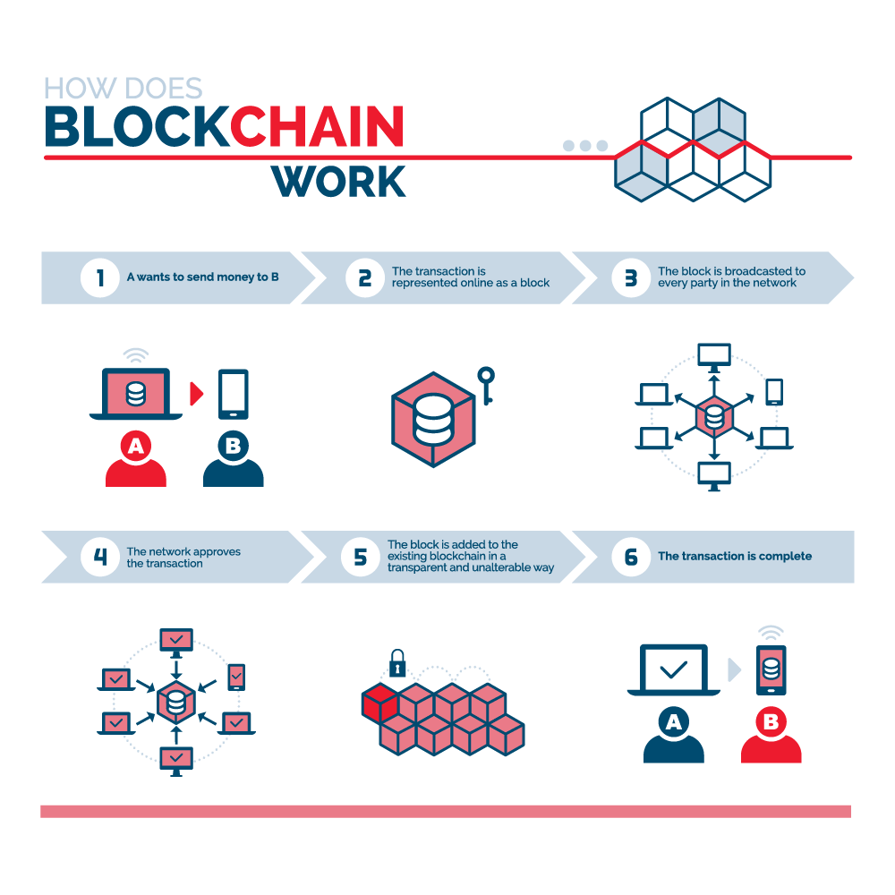
Project Goals & Components
Educational Focus:
Designed for educational purposes to enhance understanding of blockchain concepts.
Key Components:
Blocks:
Fundamental units containing transaction data.
Blockchain:
A chain of blocks, linked using cryptographic hashes.
Wallets:
Objects storing and managing user balances.
Transactions:
Exchanges of value between wallets.
Hands-On Learning:
Provides a practical and interactive experience.
Demonstrates the interaction between transactions, blocks, and wallets.
Educational Objectives:
Showcase real-world applications of blockchain technology.
Illustrate the process of block creation and wallet management.

Slide 4
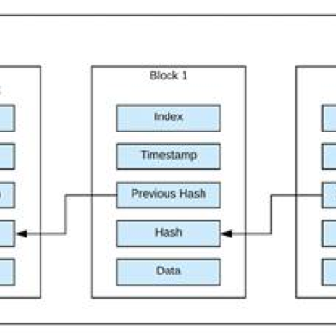
Blockchain Components
Block Class:
Attributes:
Index
Previous Hash
Timestamp
Data
Hash
Sender (Optional)
Receiver (Optional)
Block Interconnection:
Blocks are linked in a chain, creating a chronological sequence of transactions.
Each block's hash is based on the previous block's information.
Block Information:
Index:
Unique identifier for each block.
Previous Hash:
Cryptographic hash of the previous block.
Timestamp:
Time of block creation.
Data:
Details of the transaction or record.
Hash:
Cryptographic hash of the block's information.
Sender and Receiver:
(Optional) Information about the sender and receiver in a transaction.

Slide 5
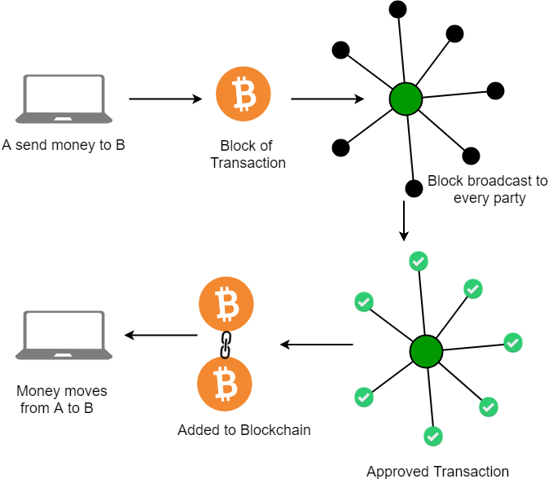
Blockchain Class
Blockchain Initialization:
The Blockchain class is responsible for managing the chain of blocks.
Initialized with the creation of the Genesis block – the first block in the blockchain.
Genesis Block:
The initial block (Block 0) with a predefined hash.
Contains basic information to initiate the blockchain.
Chain Attribute:
Stores and manages the sequence of blocks.
Grows as new blocks are added to the chain.
Calculate Hash Function:
Computes the hash of a block based on its index.
Utilizes the block's information, including index, previous hash, timestamp, and data.
Add Block Method:
Appends a new block to the chain.
Involves calculating the hash, creating a new block, and updating the blockchain.

Slide 6
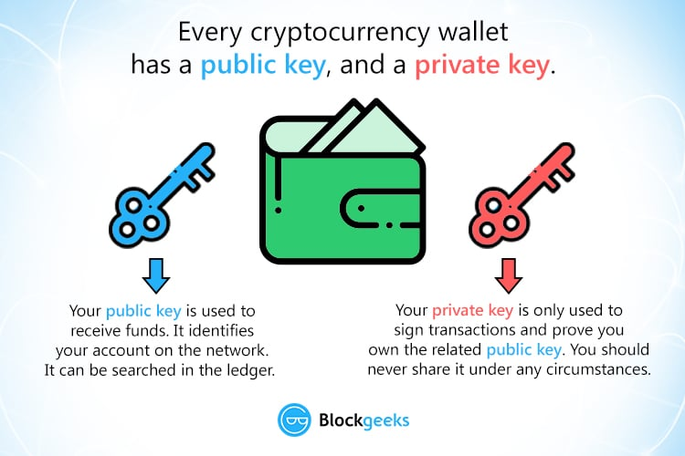
Wallet Class
Wallet Attributes:
userName (private key):
Unique identifier for the wallet owner.
walletID (public key):
Unique identifier for the wallet, often a combination of letters and numbers.
walletBalance:
Represents the amount of WesleyCoin in the wallet.
User-Focused Functionality:
Allows users to interact with the blockchain.
Manages user-specific information such as name, ID, and balance.
Wallet Creation:
Generates a unique wallet ID for each user.
Initializes with a default balance, promoting accessibility for educational purposes.
Transaction Involvement:
Participates in transactions by sending and receiving WesleyCoin.
Wallet balances are updated accordingly.

Slide 7
User Interaction & Commands
Available Commands:
user_creation:
Purpose: Create a new user and associated wallet.
Procedure: Enter username and initial balance.
commit_transaction:
Purpose: Initiate a transaction between two wallets.
Procedure: Select sender and receiver, specify the amount to transfer.
check_balance:
Purpose: Check the balance of a specific wallet.
Procedure: Choose a wallet to view the current balance.
display_chain:
Purpose: View the current state of the blockchain.
Procedure: Displays block details, including hash, timestamp, and data.
exit_0:
Purpose: Exit the program.
Procedure: End the execution of the demo.

Slide 8
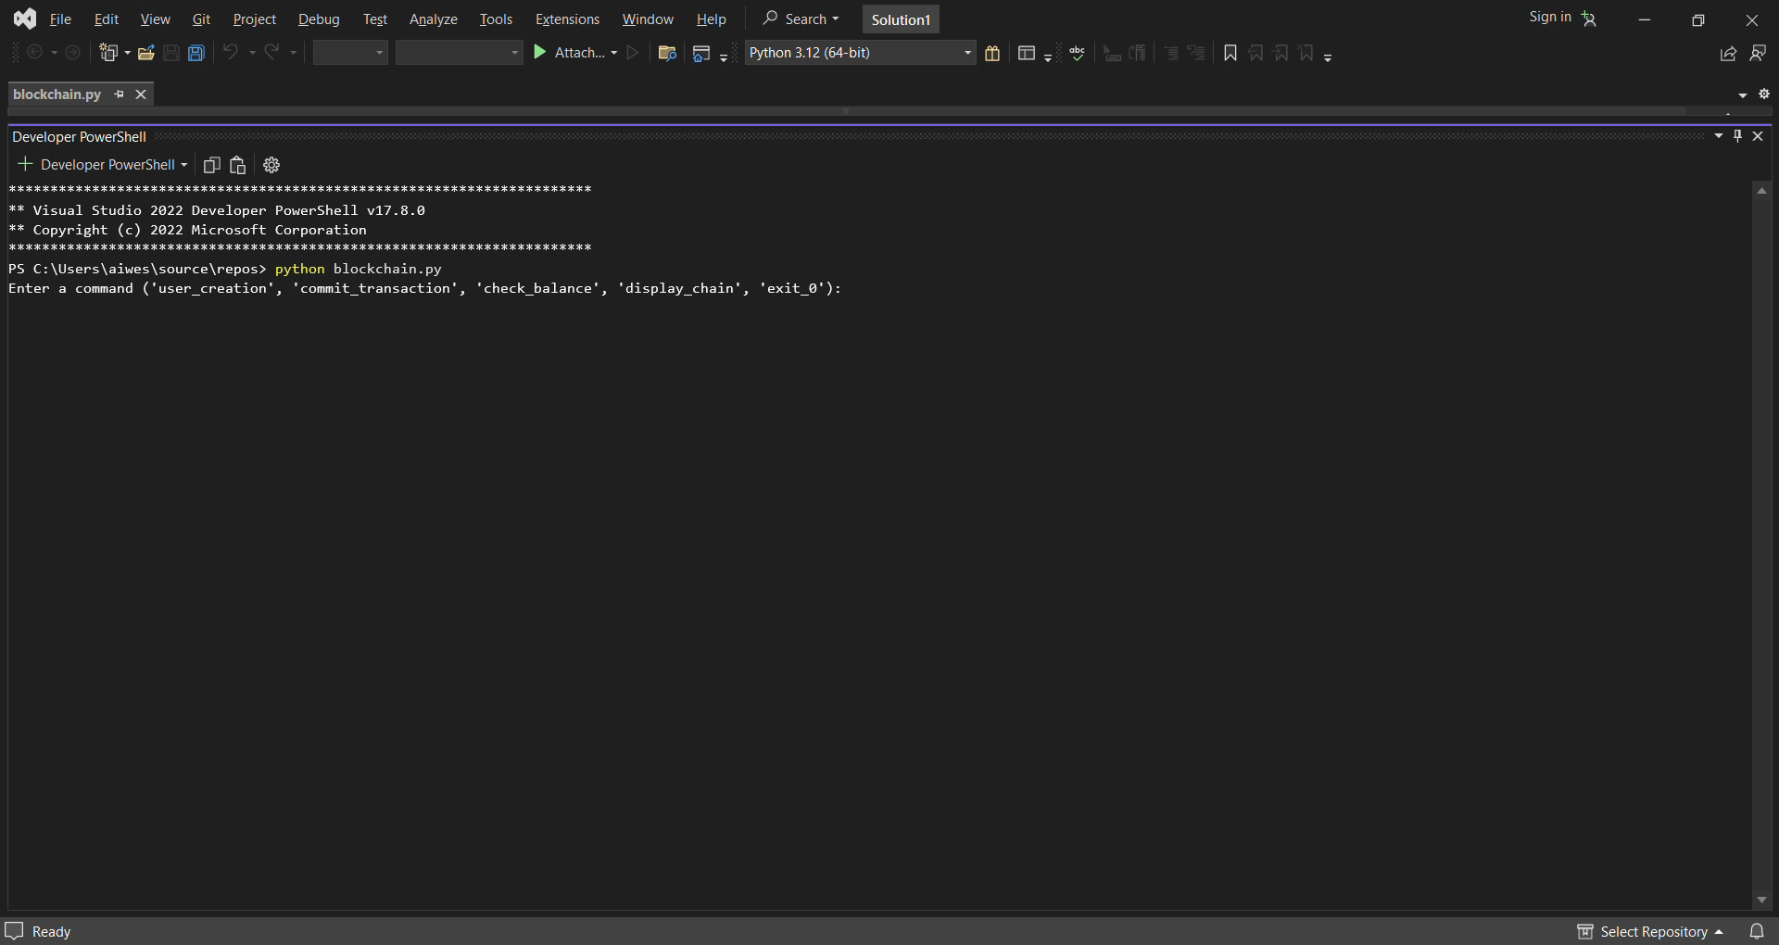
Video Demo

Slide 9
Educational Benefits
Real-World Applications:
Gain insights into the real-world applications of blockchain technology.
Understand how blockchain is utilized in various industries, including finance, supply chain, and healthcare.
Hands-On Understanding:
Interact with a simplified blockchain system for practical learning.
Enhance understanding of key blockchain concepts, such as blocks, transactions, and wallet management.
Transaction Dynamics:
Explore the dynamics of secure and transparent transactions within a decentralized system.
Witness firsthand how blockchain eliminates the need for intermediaries in certain transactions.
Blockchain Concepts:
Grasp the fundamentals of blockchain architecture and how blocks are linked in a chronological chain.
Understand the significance of cryptographic hashes in ensuring the integrity of the blockchain.
Wallet Management:
Learn how wallets are created, and observe their role in the initiation and receipt of transactions.
Explore the concept of wallet balances and how they reflect the state of the blockchain.
Problem-Solving Skills:
Develop problem-solving skills by executing commands to create users, initiate transactions, and check balances.
Engage in critical thinking to understand the cause-and-effect relationships within the blockchain system.
Interactive Learning Experience:
Experience an interactive learning environment that combines theoretical knowledge with practical application.
Encourage active participation and engagement to solidify understanding.
Educational Exploration:
Foster a spirit of exploration and experimentation within the blockchain space.
Provide a foundation for further exploration into advanced blockchain concepts and technologies.

Slide 10

Questions about the blockchain?

Slide 11
References
Blockgeeks
Title: Cryptocurrency Wallet Guide
URL: https://blockgeeks.com/guides/cryptocurrency-wallet-guide/
GeeksforGeeks
Title: Blockchain Technology - Introduction
URL: https://www.geeksforgeeks.org/blockchain-technology-introduction/
SphereGen
Title: Blockchain Technology Basics
URL: https://www.spheregen.com/blockchain-technology-basics/
ResearchGate
Title: Simplified diagram of a blockchain
URL: https://www.researchgate.net/figure/Simplified-diagram-of-a-blockchain_fig1_332715800
Trenton Systems
Title: Blockchain Explained: The Complete Guide - Part 1
URL: https://www.trentonsystems.com/blog/blockchain-explained-the-complete-guide-part-1
Simplilearn - Blockchain Tutorial
Title: Blockchain Tutorial
URL: https://www.simplilearn.com/tutorials/blockchain-tutorial/blockchain-technology
Simplilearn - Blockchain Wallet
Title: Blockchain Wallet
URL: https://www.simplilearn.com/tutorials/blockchain-tutorial/blockchain-wallet
Visual Studio Code
Title: Visual Studio Code
URL: https://code.visualstudio.com/
Python Official Website
Title: Python
URL: https://www.python.org/

